Slide 1
Instructor Training Slides
MMPI®-3 Instructor Training Slides, University of Minnesota Press,
Copyright for all MMPI® materials are held by the Regents of the University of Minnesota

Slide 2
Part 2:
Unit 1: Validity Scales
Unit 2: Higher-Order (H-O Scales)
Unit 3: Restructured Clinical (RC) Scales
Unit 4: Specific Problems (SP) Scales
Unit 5: Personality Psychopathology Five (PSY-5) Scales
Part 2:
MMPI-3 Scales

Slide 3
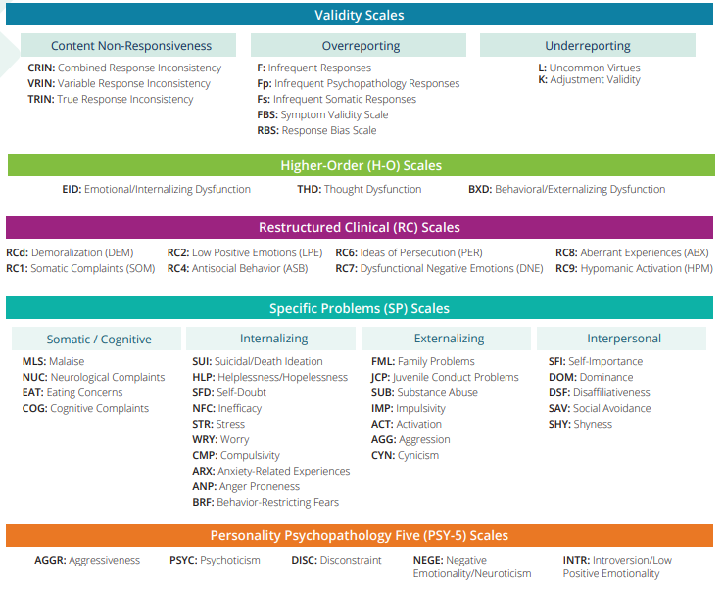

Slide 4
Unit 1: Validity Scales

Slide 5

Validity Scales
CRIN Combined Response Inconsistency – Combination of variable and fixed inconsistent responding
VRIN Variable Response Inconsistency – Variable inconsistent responding
TRIN True Response Inconsistency – Fixed inconsistent responding
F Infrequent Responses – Responses infrequent in the general population
Fp Infrequent Psychopathology Responses – Responses infrequent in psychiatric populations
Fs Infrequent Somatic Responses – Somatic complaints infrequent in medical patient populations
FBS Symptom Validity Scale – Noncredible somatic and cognitive complaints
RBS Response Bias Scale – Exaggerated memory complaints
L Uncommon Virtues – Rarely claimed moral attributes or activities
K Adjustment Validity – Claims of uncommonly high level of psychological adjustment

Slide 6
Validity Scales
Variable Inconsistency
  An inconsistent combination of “True” and “False” responses
    I am always happy (True)
    I was happy yesterday (False)
  Note that the opposite combination is NOT inconsistent
    I am always happy (False)
    I was happy yesterday (True)

Slide 7
Validity Scales
Fixed Inconsistency
  An inconsistent combination of “True” and “True” responses
    I am always happy (True)
    I am always sad (True)
  Note that the opposite combination is NOT inconsistent
    I am always happy (False)
    I am always sad (False)
  OR an inconsistent combination of “False” and “False” responses
    I am shy (False)
    I am not shy (False)
  In this case, the opposite combination IS inconsistent
    I am shy (True)
    I am not shy (True)

Slide 8
Excerpted from the MMPI-3 Technical Manual by Yossef S. Ben-Porath and Auke Tellegen. Copyright © 2020 by the Regents of the University of Minnesota. Reproduced by permission of the University of Minnesota Press.

Slide 9
Excerpted from the MMPI-3 Technical Manual by Yossef S. Ben-Porath and Auke Tellegen. Copyright © 2020 by the Regents of the University of Minnesota. Reproduced by permission of the University of Minnesota Press.

Slide 10
Reliability and SEM

Slide 11
Excerpted from the MMPI-3 Technical Manual by Yossef S. Ben-Porath and Auke Tellegen. Copyright © 2020 by the Regents of the University of Minnesota. Reproduced by permission of the University of Minnesota Press.

Slide 12
Excerpted from the MMPI-3 Technical Manual by Yossef S. Ben-Porath and Auke Tellegen. Copyright © 2020 by the Regents of the University of Minnesota. Reproduced by permission of the University of Minnesota Press.

Slide 13
Validity – Non-content-based Invalidity

Slide 23
Non-content-based Invalid Responding Indicators
Primary threat detected:
  Artifactual increase or decrease in substantive scale scores
    Non-responding artifactually lowers scores
      Impact begins at 10% unscorable responses
    Random responding artifactually increases scores
      Scales with low frequency items most impacted
    Fixed responding can artifactually increase or decrease substantive scale scores
      Impact depends on scoring key

Slide 24
Validity – Content-based Invalidity Indicators

Slide 37
Content-based Invalid Responding Indicators
Effectively identify simulated over-reporting and under-reporting
Good classification accuracy statistics
Over-reporting and under-reporting substantially attenuate substantive scale score validity

Slide 38
Content-based Invalid Responding Indicators
Two functions:
  Assessing threats to protocol validity
    Just addressed
  Detecting malingering and concealment of psychopathology
    Not developed for this purpose
    Literature supports their effectiveness for this function

Slide 39
Unit 2: Higher-Order (H-O) Scales

Slide 40
Higher-Order (H-O) Scales
EID Emotional/Internalizing Dysfunction – Problems associated with mood and affect
THD Thought Dysfunction – Problems associated with disordered thinking
BXD Behavioral/Externalizing Dysfunction – Problems associated with under-controlled behavior

Slide 41
Unit 3: Restructured Clinical (RC) Scales

Slide 42
Restructured Clinical (RC) Scales
RCd Demoralization – General unhappiness and dissatisfaction
RC1 Somatic Complaints – Diffuse physical health complaints
RC2 Low Positive Emotions – Lack of positive emotional responsiveness
RC4 Antisocial Behavior – Rule breaking and irresponsible behavior
RC6 Ideas of Persecution – Self-referential beliefs that others pose a threat
RC7 Dysfunctional Negative Emotions – Maladaptive anxiety, anger, irritability
RC8 Aberrant Experiences – Unusual perceptions or thoughts associated with thought dysfunction
RC9 Hypomanic Activation – Overactivation, aggression, impulsivity, and grandiosity

Slide 43
Unit 4: Specific Problems Scales

Slide 44
Specific Problems Scales
Somatic/Cognitive
  MLS Malaise – Overall sense of physical debilitation, poor health
  NUC Neurological Complaints – Dizziness, weakness, paralysis, loss of balance, etc.
  EAT Eating Concerns – Problematic eating behaviors
  COG Cognitive Complaints – Memory problems, difficulties concentrating

Slide 45
Specific Problems Scales
Internalizing (Demoralization Related)
  SUI Suicidal/Death Ideation – Direct reports of suicidal ideation
  and recent attempts
  HLP Helplessness/Hopelessness – Belief that goals cannot be reached or problems solved
  SFD Self-Doubt – Lack of self-confidence, feelings of uselessness
  NFC Inefficacy – Belief that one is indecisive and inefficacious

Slide 46
Specific Problems Scales
Internalizing (Negative Emotions Related)
  STR Stress – Problems involving stress and nervousness
  WRY Worry – Excessive worry and preoccupation
  CMP Compulsivity – Engaging in compulsive behaviors
  ARX Anxiety-Related Experiences – Multiple anxiety-related experiences such as catastrophizing, panic, dread, and intrusive ideation
  ANP Anger Proneness – Becoming easily angered, impatient with others
  BRF Behavior-Restricting Fears – Fears that significantly inhibit normal behavior

Slide 47
Specific Problems Scales
Externalizing
  FML Family Problems – Conflictual family relationships
  JCP Juvenile Conduct Problems – Difficulties at school and
  at home, stealing
  SUB Substance Abuse – Current and past misuse of alcohol
  and drugs
  IMP Impulsivity – Poor impulse control and non-planful behavior
  ACT Activation – Heightened excitation and energy level
  AGG Aggression – Physically aggressive, violent behavior
  CYN Cynicism – Non-self-referential beliefs that others are
  bad and not to be trusted

Slide 48
Specific Problems Scales
Interpersonal
  SFI Self-Importance – Beliefs related to having special talents
  and abilities
  DOM Dominance – Being domineering in relationships with others
  DSF Disaffiliativeness – Disliking people and being around them
  SAV Social Avoidance – Not enjoying and avoiding social events
  SHY Shyness – Feeling uncomfortable and anxious in the presence
  of others

Slide 49
Unit 5: Personality Psychopathology Five (PSY-5) Scales

Slide 50
PSY-5 Scales
AGGR Aggressiveness – Instrumental, goal-directed aggression
PSYC Psychoticism – Disconnection from reality
DISC Disconstraint – Under-controlled behavior
NEGE Negative Emotionality/Neuroticism – Anxiety, insecurity, worry, and fear
INTR Introversion/Low Positive Emotionality – Social disengagement and anhedonia

Slide 51
PSY-5 Scales
Three Models:
FFM | PSY-5 | DSM-5 Alternative Model of PDs
Agreeability | Aggressiveness | Antagonism
Openness | Psychoticism | Psychoticism
Conscientiousness | Disconstraint | Disinhibition
Neuroticism | Negative Emotionality | Negative Affect
Extraversion | Low Positive Emotionality | Detachment

Slide 52
End of Part 2

